Slide 1
Introduction to Statistical Methods
Dr Y V K Ravi Kumar, BITS- Pilani

Slide 2
Session 2: Probability

Slide 3
Agenda
Probability
Conditional Probability
3

Slide 4
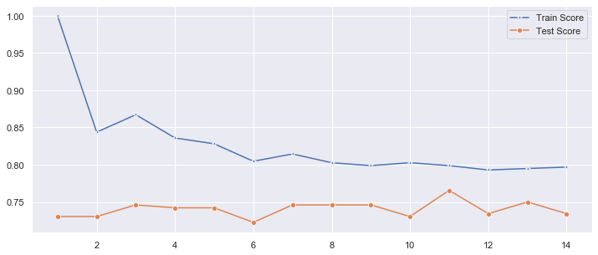

Slide 5
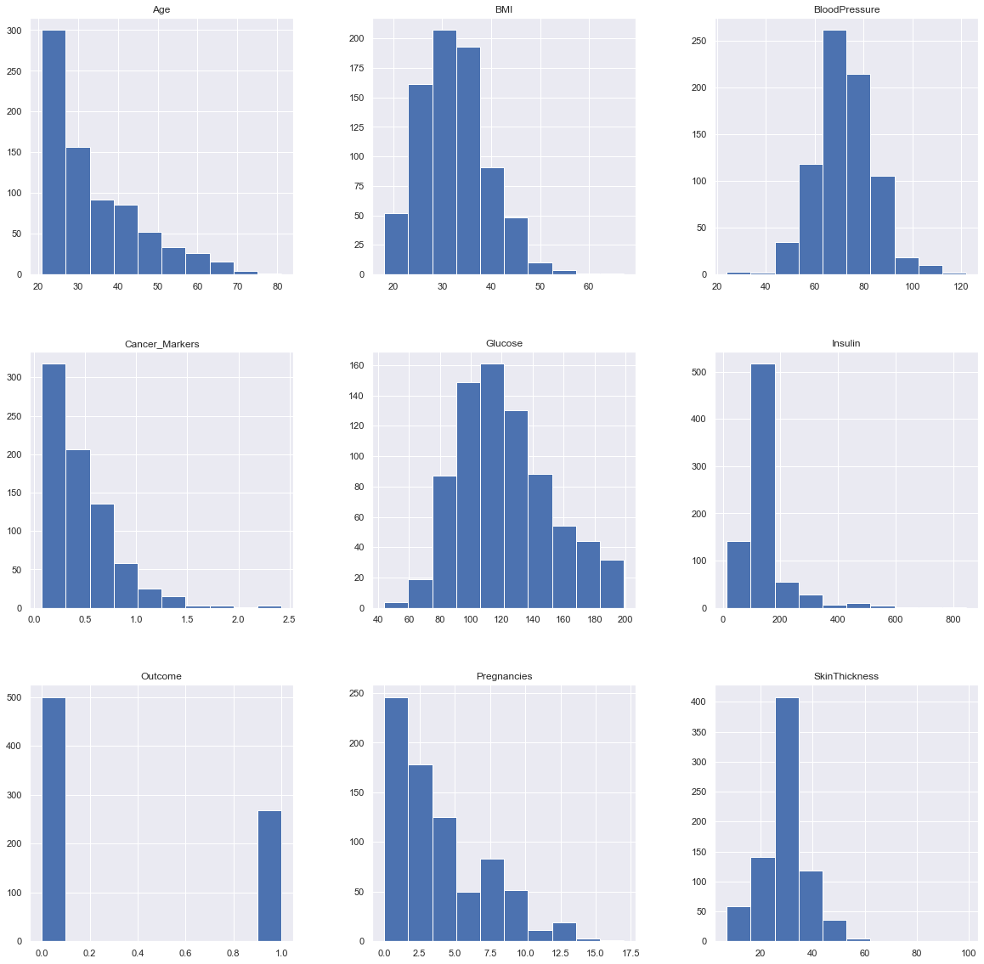

Slide 6
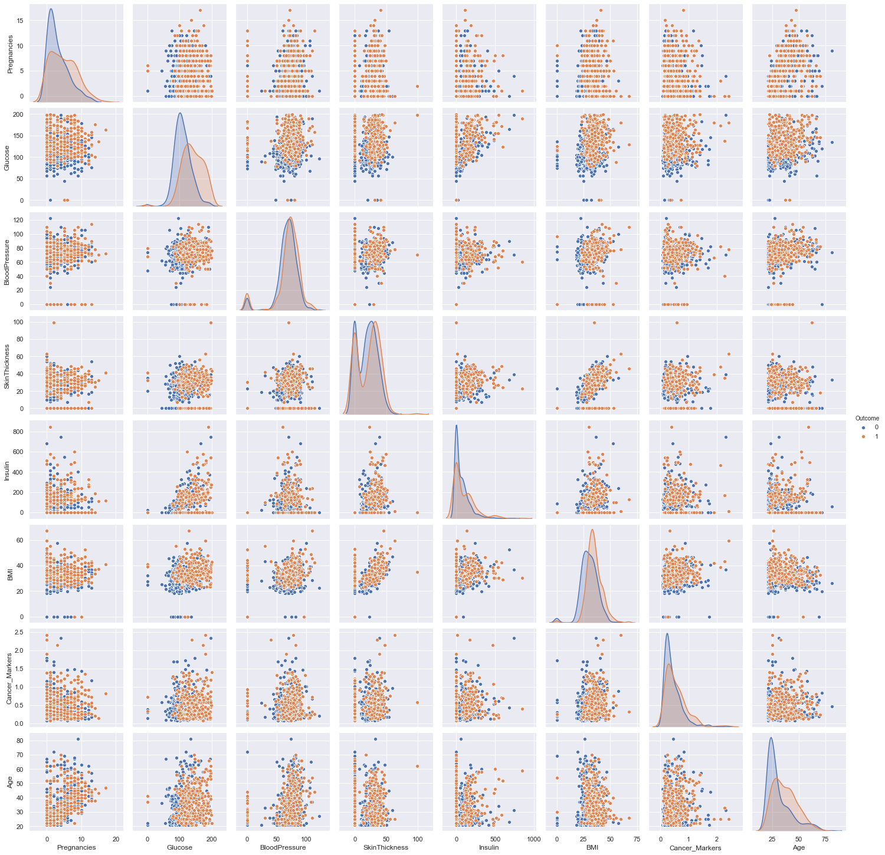

Slide 7
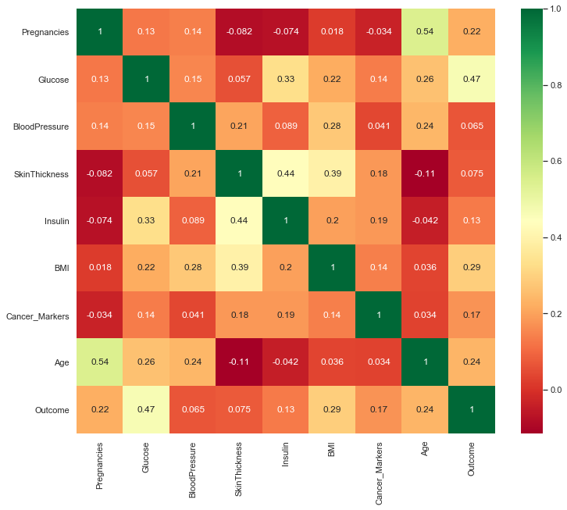

Slide 8
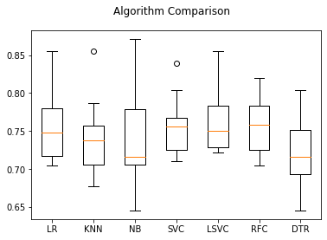

Slide 9

Measures of Central Tendency
Measure of central tendency provides a very convenient way of describing a set of scores with a single number that describes the PERFORMANCE of the group.
Also defined as a single value that is used to describe the “center” of the data.
Three commonly used measures of central tendency:
Mean
Median
Mode

Slide 10
The Mode
The category or score with the largest frequency (or percentage) in the distribution.
The mode can be calculated for variables with levels of measurement that are: nominal, ordinal, or interval-ratio.
Example:
Number of Votes for Candidates for Lok Sabha MP. The mode, in this case, gives you the “central” response of the voters: the most popular candidate.
Candidate A – 11,769 votes The Mode:
Candidate B – 39,443 votes “Candidate C”
Candidate C – 78,331 votes
Notes:
For a nominal variable, the mode is the only measure that can be used.
For ordinal variables, the mode and the median may be used. The median provides more information (taking into account the ranking of categories.)
For interval-ratio variables, the mode, median, and mean may all be calculated. The mean provides the most information about the distribution, but the median is preferred if the distribution is skewed.

Slide 11
The Median
The score that divides the distribution into two equal parts, so that half the cases are above it and half below it.
The median is the middle score, or average of middle scores in a distribution.
Fifty percent (50%) lies below the median value and 50% lies above the median value.
It is also known as the middle score or the 50th percentile.

Slide 12
Median
Properties
It may not be an actual observation in the data set.
Not affected by extreme values because median is a positional measure.
Can be applied in ordinal level.
When to Use the Median
The exact midpoint of the score distribution is desired.
There are extreme scores in the distribution.

Slide 13



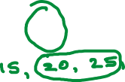
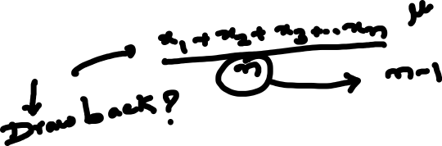
Measures of central tendency
The mean
the median
the mode

Slide 14
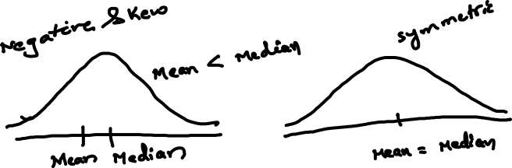
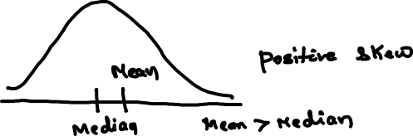

Slide 15
Shape of the Distribution
Symmetrical : mean is about equal to median
Skewed
Negatively : mean < median
Positively : mean > median
Bimodal : has two distinct modes
Multi-modal : has more than 2 distinct modes)
Notes:
Draw Examples on the board

Slide 16
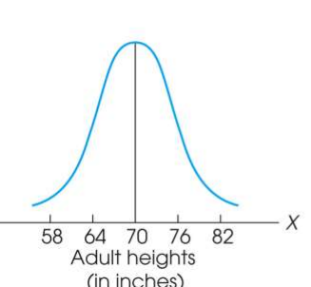
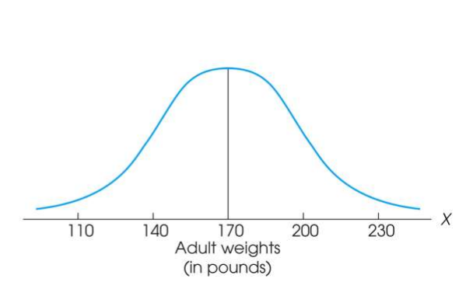
Measure of Variability
Variability can be defined several ways:
A quantitative distance measure based on the differences between scores
Describes distance of the spread of scores or distance of a score from the mean
Purposes of Measure of Variability:
Describe the distribution
Measure how well an individual score represents the distribution

Slide 17
The Three Measures
Three Measures of Variability:
The Range
The Variance
The Standard Deviations

Slide 18

The Standard Deviation
New Strategy :
First square each deviation score
Then sum the Squared Deviations (SS)
Average the squared deviations
Mean Squared Deviation is known as “Variance”
Variability is now measured in squared units

Slide 19
Interquartile range (IQR)
Measure of Variation
Also Known as Midspread: Spread in the Middle 50%
Difference Between Third & First Quartiles:
Not Affected by Extreme Values
Interquartile Range = Q₃ – Q₁
Data in Ordered Array: 11 12 13 16 16 17 17 18 21
1•(9 + 1)
Position of Q₁
=
= 2.50,
Q₁
=12.5
4
3•(9 + 1)
Position of Q₃
=
= 7.50,
Q₃
=17.5
4
Interquartile Range = Q₃ – Q₁ = 17.5 - 12.5 = 5

Slide 20
Box and Whisker plot
97.5th Centile
75th Centile
Q₁
MEDIAN
(50th centile)
Q₂
25th Centile
Q₃
Inter-quartile range
2.5th Centile

Slide 21
Box and Whisker plot
IQR = Q₃ – Q₁
Q₁-1.5 IQR
Q₃+1.5 IQR
Min
Max
Q₁
Q₂
Q₃
Outlier
Outlier

Slide 22
Box-and-Whisker plot
IQR = Q₃ – Q₁
Min
Q₁-1.5 IQR
Q₃+1.5 IQR
Max
Q₁
Q₂
Q₃
Q₃+3 IQR
Q₁-3 IQR
Major Outlier
Major Outlier

Slide 23

The Sample Space of an Experiment

Slide 24
Example 2.1
The simplest experiment to which probability applies is one with two possible outcomes.
One such experiment consists of examining a single weld to see whether it is defective.
The sample space for this experiment can be abbreviated as = {N,D},where N represents not defective, D represents defective, and the braces are used to enclose the elements of a set.

Slide 25

Events

Slide 26
Example 2.5
Consider an experiment in which each of three vehicles taking a particular freeway exit turns left (L) or right (R) at the end of the exit ramp.
The eight possible outcomes that comprise the sample space are LLL, RLL, LRL, LLR, LRR, RLR, RRL, and RRR.
Thus there are eight simple events, among which are E₁ = {LLL} and E₅ = {LRR}.

Slide 27
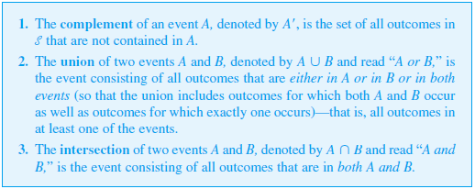
Some Relations from Set Theory

Slide 28

Some Relations from Set Theory

Slide 29
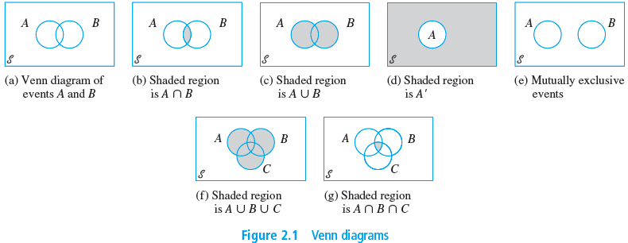
Some Relations from Set Theory

Slide 30
Axioms, Interpretations,
and Properties of Probability
2.2
Copyright © Cengage Learning. All rights reserved.

Slide 31
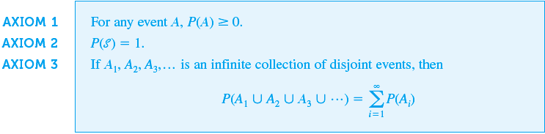
Axioms, Interpretations, and Properties of Probability

Slide 32

Axioms, Interpretations, and Properties of Probability

Slide 33
More Probability Properties

Slide 35


Slide 36
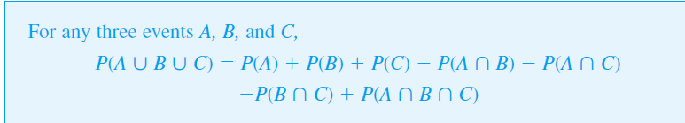

Slide 37
Equally Likely Outcomes

Slide 38
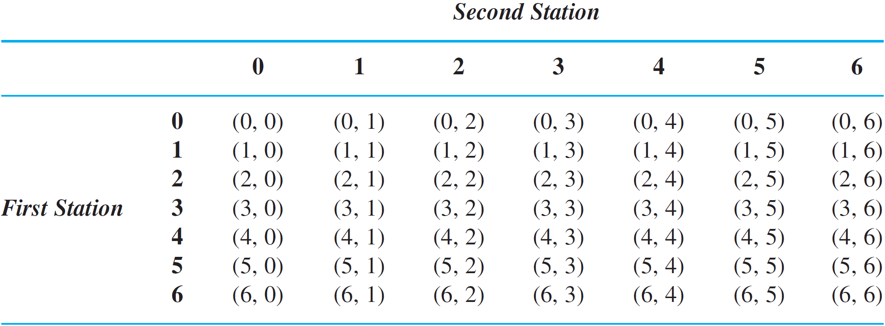
Example 2.16
cont’d
Then each outcome is a pair of numbers such as (4, 1), and there are N = 36 possible outcomes (For a visual of this situation, refer the table below and delete the first row and column).

Slide 39
Example 2.16
cont’d
With random selection as described, the 36 outcomes are equally likely.
Nine of these outcomes are such that both selected books are paperbacks (those in the lower right-hand corner of the referenced table): (4, 4), (4, 5), . . . , (6, 6).
So the probability of the event A that both selected books are paperbacks is

Slide 40
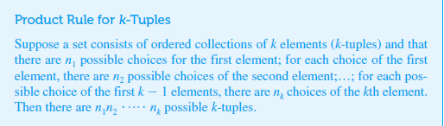
A More General Product Rule

Slide 41

Permutations and Combinations
Proposition

Slide 42


Permutations and Combinations
Generalizing the foregoing line of reasoning gives a simple relationship between the number of permutations and the number of combinations that yields a concise expression for the latter quantity.
Proposition
Notice that and since there is only one way to
choose a set of (all) n elements or of no elements, and
since there are n subsets of size 1.

Slide 43
1
The sales manager of an e commerce company says that 80% of those who visit their website for the first time do not buy any mobile. If a new customer visits the website, what is the probability that the customer would buy mobile

Slide 44
2
 | Blue | Black | Brown | Total
Software prog | 35 | 25 | 20 | 80
Project Mgrs | 7 | 8 | 5 | 20
Total | 42 | 33 | 25 | 100
If an employee is selected at random,what is the probability that he is a software prog? If an employee is selected at random,what is the probability that he is wearing a blue trouser

Slide 45
3
A Survey conducted by a bank revealed that 40% of the accounts are savings accounts and 35% of the accounts are current accounts and the balance are loan accounts.
What is the probability that an account taken at random is a loan account ?
What is the probability that an account taken at random is NOT savings account ?
What is the probability that an account taken at random is NOT a current account
What is the probability that an account taken at random is a current account or a loan account?

Slide 46
4
In a certain residential hub,60% of all households get internet service from the local cable company,80% get the television service from that company, and 50% get both services from that company.
If a household is randomly selected, what is the probability that it gets at least one of these two services from the company, and what is the probability that it gets exactly one of these services from the company?

Slide 47
Probability
A speaks truth in 75% cases and B in 80% cases. Find the probability that they are likely to contradict each other in stating the same fact?

Slide 48
2.4
Conditional Probability
Copyright © Cengage Learning. All rights reserved.

Slide 49
Conditional Probability
We will use the notation P(A | B) to represent the conditional probability of A given that the event B has occurred. B is the “conditioning event.” As an example, consider the event A that a randomly selected student at your university obtained all desired classes during the previous term’s registration cycle. Presumably P(A) is not very large.
However, suppose the selected student is an athlete who gets special registration priority (the event B). Then P(A | B) should be substantially larger than P(A), although perhaps still not close to 1.

Slide 50
Probability
From a city population , the probability of selecting a male or a smoker is 7/10, a male smoker is 2/5, and a male if a smoker is already selected is 2/3.
Find the probability of selecting
A non – smoker
A male
A smoker, if a male is first selected

Slide 51
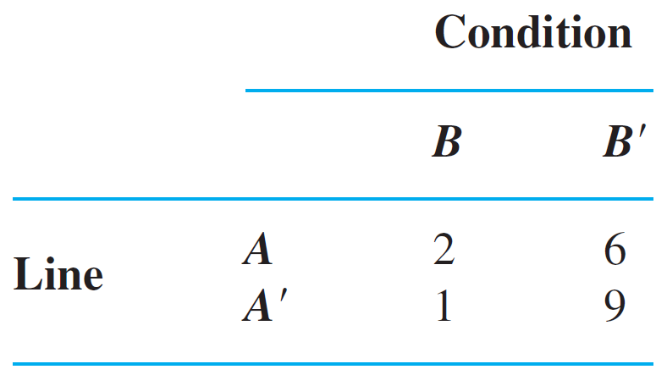
Example 2.24
This information is summarized in the accompanying table.
Unaware of this information, the sales manager randomly selects 1 of these 18 components for a demonstration. Prior to the demonstration P(line A component selected) = P(A) = .44

Slide 52
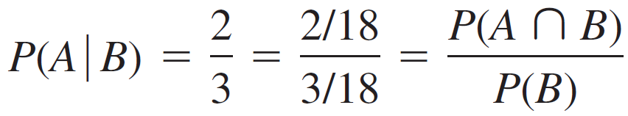
Example 2.24
However, if the chosen component turns out to be defective, then the event B has occurred, so the component must have been 1 of the 3 in the B column of the table.
Since these 3 components are equally likely among themselves after B has occurred,
(2.2)

Slide 53
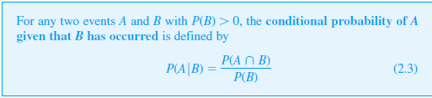
The Definition of Conditional Probability
Definition

Slide 54
Example 2.25
Suppose that of all individuals buying a certain digital camera, 60% include an optional memory card in their purchase, 40% include an extra battery, and 30% include both a card and battery. Consider randomly selecting a buyer and let
A = {memory card purchased} and B = {battery purchased}.
Then P(A) = .60, P(B) = .40, P(both purchased) = P(A ∩ B) = .30

Slide 55

Example 2.25
cont’d
Given that the selected individual purchased an extra battery, the probability that an optional card was also purchased is
That is, of all those purchasing an extra battery, 75% purchased an optional memory card. Similarly, P (battery | memory card) =
Notice that ≠ P(A) and ≠ P(B).

Slide 56

The Multiplication Rule for P(A ∩ B)
The definition of conditional probability yields the following result, obtained by multiplying both sides of Equation (2.3) by P(B). The Multiplication Rule This rule is important because it is often the case that P(A ∩ B) is desired, whereas both P(B) and can be specified from the problem description. Consideration of gives P(A ∩ B) =  P(A)

Slide 57

Example 2.27
Four individuals have responded to a request by a blood bank for blood donations. None of them has donated before, so their blood types are unknown. Suppose only type O+ is desired and only one of the four actually has this type. If the potential donors are selected in random order for typing, what is the probability that at least three individuals must be typed to obtain the desired type?
Making the identification B = {first type not O+} and
A = {second type not O+}, P(B) =

Slide 58
Example 2.27
cont’d
Given that the first type is not O+, two of the three
individuals left are not O+, so
The multiplication rule now gives
P (at least three individuals are typed) = P(A ∩ B)

Slide 59

Example 2.27
cont’d
The multiplication rule is most useful when the experiment consists of several stages in succession.
The conditioning event B then describes the outcome of the first stage and A the outcome of the second, so that —conditioning on what occurs first—will often be known.
The rule is easily extended to experiments involving more than two stages.

Slide 60
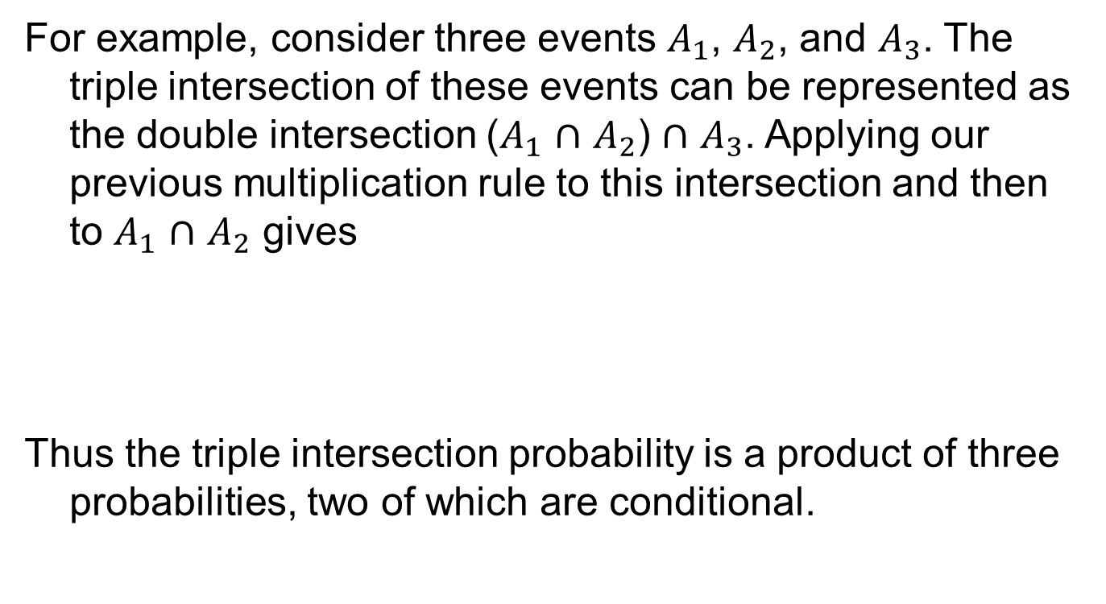
Example 2.27
cont’d

Slide 61

Bayes’ Theorem
The computation of a posterior probability from given prior probabilities P(A_{i}) and conditional probabilities occupies a central position in elementary probability. The general rule for such computations, which is really just a simple application of the multiplication rule, goes back to Reverend Thomas Bayes, who lived in the eighteenth century. To state it we first need another result. Recall that events A₁, . . . , A_{k} are mutually exclusive if no two have any common outcomes. The events are exhaustive if one A_{i} must occur, so that A₁ ∪ …∪ A_{k} =

Slide 62
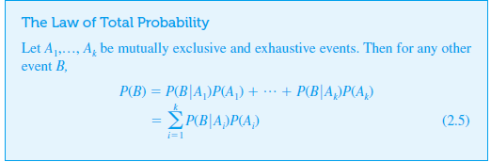

Slide 63
1
Three persons A,B and C are competing for the post of CEO of a company. The chances of they becoming CEO are 0.2,0.3 and 0.4 respectively.
The chances of they taking employees beneficial decisions are 0.50,0.45 and 0.6 respectively
What are the chances of having employees beneficial decisions after having new CEO

Slide 64
Example 2.30
An individual has 3 different email accounts. Most of her messages, in fact 70%, come into account #1, whereas 20% come into account #2 and the remaining 10% into account #3.
Of the messages into account #1, only 1% are spam, whereas the corresponding percentages for accounts #2 and #3 are 2% and 5%, respectively.
What is the probability that a randomly selected message is spam?

Slide 65
Example 2.30
cont’d
To answer this question, let’s first establish some notation:
A_{i} = {message is from account # i} for i = 1, 2, 3,
B = {message is spam}
Then the given percentages imply that P(A₁) = .70, P(A₂) = .20, P(A₃) = .10

Slide 66
Example 2.30
cont’d
Now it is simply a matter of substituting into the equation for the law of total probability: P(B) = (.01)(.70) + (.02)(.20) + (.05)(.10) = .016 In the long run, 1.6% of this individual’s messages will be spam.

Slide 67
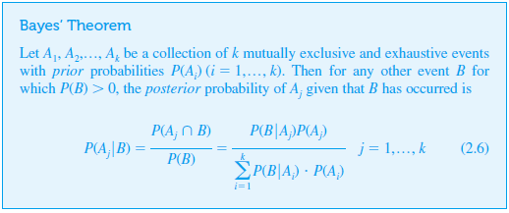
Bayes’ Theorem

